Slide 1
Comparison and Performance Analysis of Cache Coherence Protocols using Gem5 Simulator
CSC5593 - Advanced Computer Architecture
Manish Rudra Vijayakumar
Madhan Vibeeshanan
Keerthana Sharon Kannan

Slide 2
Introduction
Higher the processor frequency, faster the computer
Shift from Uni-processors to Multi-Processors with shared memory
The possibility of many copies of shared data is higher as there is a separate cache memory for each processor.
One copy in the main memory and one in the local cache of each processor that requested it.

Slide 3
Cache Coherence problem
Two different cores have two different values for the same location.
Must guarantee that all the processors see correct data despite multiple readers and writers.
Cache coherence problem leads to another category of cache miss named coherence miss along with compulsory, capacity and conflict misses.
Coherence miss occurs when the local cache copy of a node is updated, and all other copies are invalidated.

Slide 4
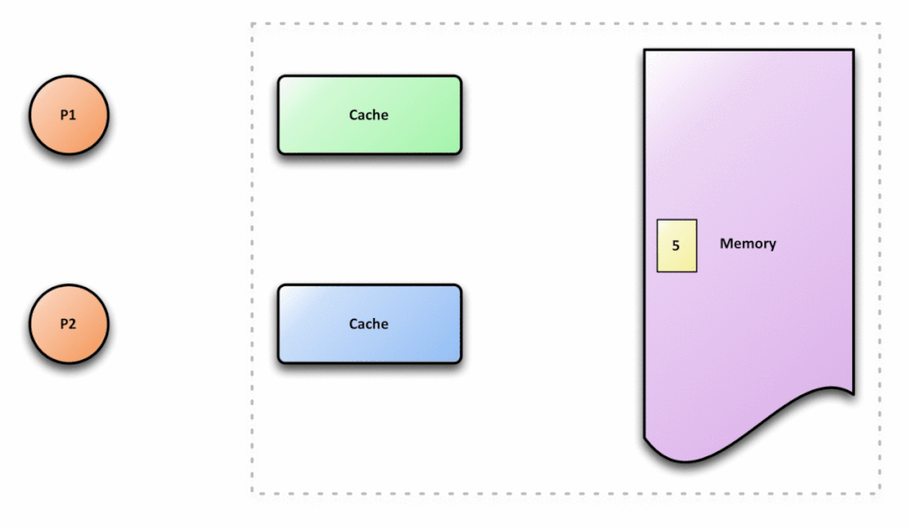
Cache Incoherence

Slide 5
Cache Coherence
Ensures that the changes in the values of the shared operand are propagated throughout the system in a timely fashion.
Cache coherent processor has the most current value
Cache Coherence Requirements:
Write Propagation – Broadcast to peer caches
Transaction serialization – Read/Writes must be seen by all processors in the same order.

Slide 6

Cache Coherence

Slide 7
Solutions
Coherence
Software
Hardware
Directory based Coherence
Snoopy Coherence
Hybrid Coherence
Write-update
Write-invalidate

Slide 8
Solutions
Software:
Reduce the hardware complexity of cache coherence using software programming models.
Use cache flush and invalidate
Hardware:
Closely interacts with the interconnection network
Read/write operations is known to all other processors to update the shared block

Slide 9
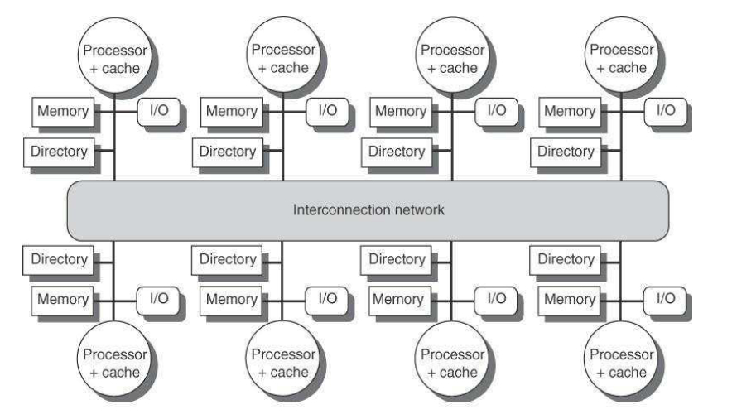
Directory Coherence
Uses the directory to store the sharing status of the memory block and thus has a low broadcast requirement.
Incur storage overhead and are prone to design bugs

Slide 10
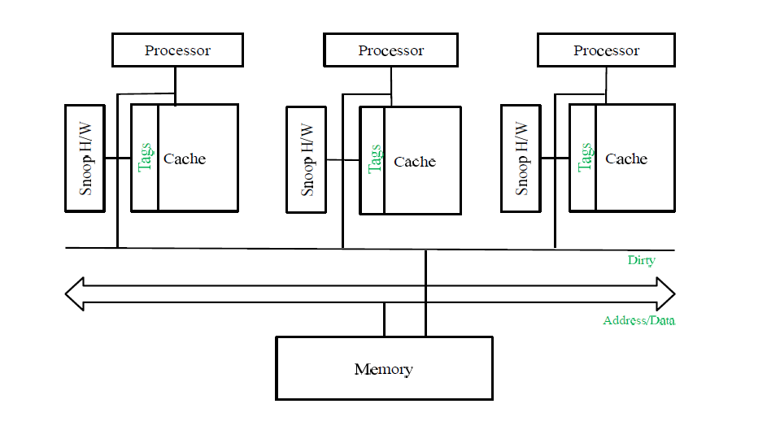
Snoopy Coherence
Cache controller broadcasts the request and monitors the memory bus activity to maintain consistent data.
Not scalable.

Slide 11
Coherence Requirements
Cache To Cache Transfer
Efficient Bandwidth
Avoid Bus communication

Slide 12
Coherence Requirements
Low latency Cache to cache transfer – Transfer of data through cache to cache instead of transferring it through main memory.
Directory - Directs the request to destination cache and waits for acknowledgment which takes extra clock cycle.
Avoiding bus-based architecture
Point to point communication
Bus architecture restricts the integration of more cores on the system
Efficient Bandwidth - Bandwidth has to be reduced to avoid interconnect contention, as it affects system performance.

Slide 13
Update vs Invalidate
Write-Update – All shared caches are updated via bus snooping
Broadcasts write throughout the bus
If data is present in only one cache, broadcasting the message is useless. It creates large bus traffic.
Write-Invalidate – Node invalidates all other cached copies of shared data and can then update its own copy without further bus operation.
Use less bandwidth

Slide 14
Cache Coherence Protocols
To deal with the coherence problem inside shared-memory multiprocessors.
Coordinate distributed caches, so as to a provide consistent view of memory to processors.
Cache Coherence Protocols:
MSI
MESI
MOSI
MOESI

Slide 15
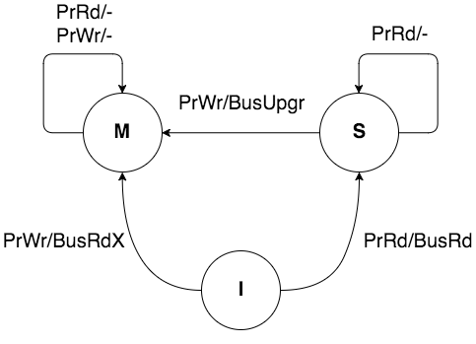
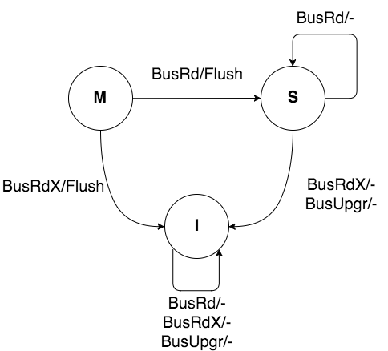
Modified Shared Invalid (MSI)
Shared (S): This block is unmodified and exists in thrread-only state in at least one cache.
The cache can evict the data without writing it to the memory.

Slide 16
Modified Shared Invalid (MSI)
State Transitions:
Invalid:
On a PrRd, BusRd is issued and state changes to Shared.
On a PrWr, BusRdX is issued and state changes to Modified.
On a BusRd, BusRdX or a BusUpgr an invalid block remains Invalid.
Shared:
On a PrRd, the block remains in the Shared state.
On a PrWr, BusUpgr is issued and state changes to Modified.
On a BusRd, the block remains in the Shared state.
On a BusRdX or BusUpgr, the block transitions to Invalid.
Modified:
On a PrRd or PrWr, the block remains in the Modified state.
On a BusRd, the cache block is flushed onto the bus and state changes to Shared.
On a BusRdX, the cache block is flushed onto the bus and state changes to Invalid.

Slide 17
Modified Shared Invalid (MSI)
Advantages:
The distinction between modified and shared state
Multiple copies of the block can be present at the same time
Disadvantages:
On read, the block goes to “S” state, even if it is the only copy present.
This problem is because when write request arrive state changes from “S” to “M” and invalidate message is broadcast on the bus, even though it is the only copy present.
Unnecessary broadcast of invalidation message.

Slide 18
Modified Exclusive Shared Invalid (MESI)
Exclusive State (E):
MESI is based on MSI protocol but one more state is added Exclusive State(E)
The cache line is present only in the current cache, and the dirty bit is not- matches with the main memory.
It may change to a shared state at any time, in response to a read request.
And it may also change to the modified state when writing to its own block.

Slide 19
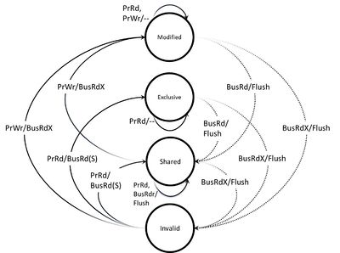
Modified Exclusive Shared Invalid (MESI)

Slide 20
Modified Exclusive Shared Invalid (MESI)
Advantages:
The silent transition from Exclusive to Modified state
Disadvantages:
Extra hardware is required for deciding the transaction of the block when read request arrives.
Every time downgrade from “M” state to “S” needs data to be written back to memory.
Tradeoffs, when the transition from “M” to “S” or “I”. Modified to shared, when data is likely to be reused and modified to invalid if data not to be reused.

Slide 21
Modified Owned Shared Invalid (MOSI)
Owned State(O):
It is an extension of basic MSI protocol but one more state is added called Owned state(o)
Multiple caches may hold the most recent and correct value of a block
The value in main memory may or may not be correct.
At a time, only one cache can have the owned state for a block.
The other caches with the same block must be in a shared state.

Slide 22
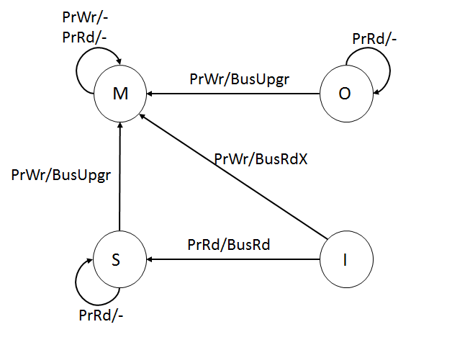
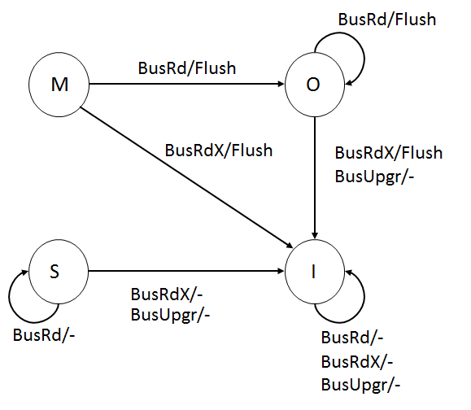
Modified Owned Shared Invalid (MOSI)

Slide 23
Modified Owned Exclusive Shared Invalid (MOESI)
MOESI is the more elaborate version of the simpler MESI protocol and the addition of owned state to it.
Cache to Cache data transfer is possible.
It avoids the need to write a dirty cache line back to main memory when another processor tries to read it.
The owned state cache allows a processor to supply the modified data directly to the other processor.

Slide 24
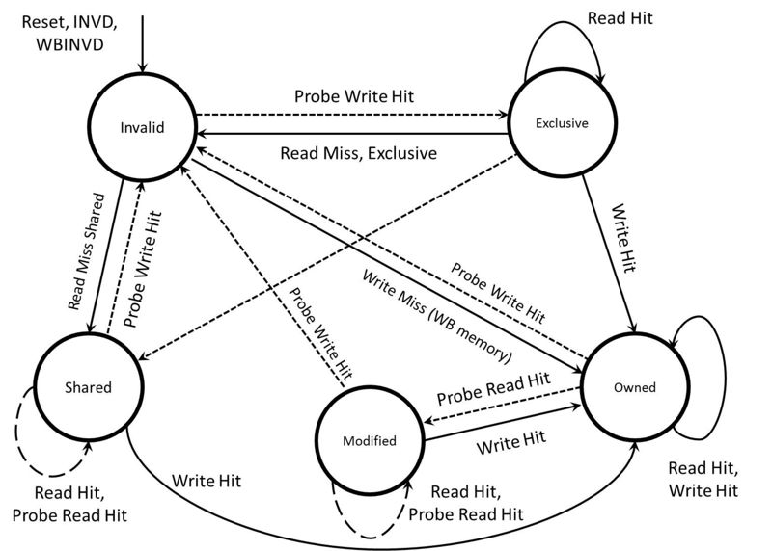
Modified Owned Exclusive Shared Invalid (MOESI)

Slide 25
Modified Owned Exclusive Shared Invalid (MOESI)
Advantages:
Avoid extra CPU stall during write-back to main memory.
One time only one cache can be owner (modified), other processors holding same block are in shared state
Disadvantages:
In snoopy implementation of MOESI, when read request arrive on bus, every sharer of the block send requested data; create message contention on the bus.

Slide 26

Gem5
Open-source software with all system components are configurable.
It is a combination of M5 and GEMS simulator.
M5: CPU models, ISAs, I/O devices, infrastructure.
GEMS: Cache Coherence Protocols, interconnect models.
Gem5 provides a very flexible environment.

Slide 27
Gem5
Gem5 supports:
Cache Coherence Protocols: MI, MESI Two Level, MESI Three level, MOESI, MOESI token and MOSEI hammer.
Memory system models: Classic and Ruby.
Replacement Policy: LRU and Pseudo-LRU
Modes: Full System mode(FS) and Syscall Emulation model(SE)
ISAs in GEM5: Alpha, ARM, SPARC, MIPS, POWER and X86 instruction set architectures.

Slide 28
Gem5
Memory Systems:
Classic memory model:
Cache Coherence is maintained using an MOESI snooping protocol.
Types of packets: Memory mapped and snooping packets
Advantages: Fast Forwarding, Speed, Easy to configure
Disadvantages: Flexibility, Fidelity

Slide 29
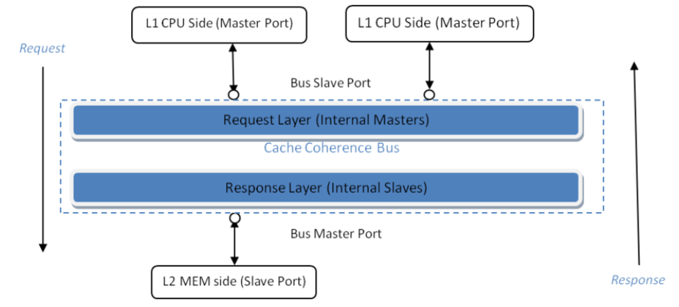
Gem5

Slide 30
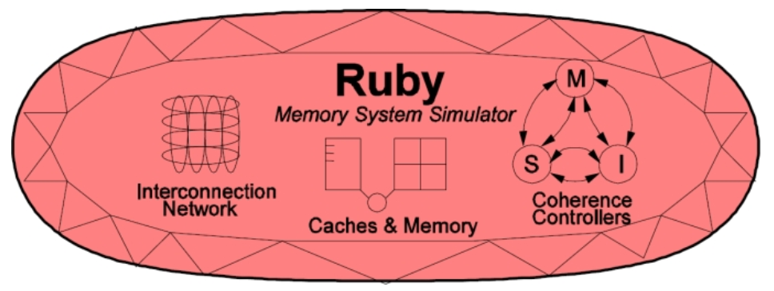
Gem5
Memory Systems:
Ruby memory model:
Adapted from GEMS simulators.
It is a contrast to classic memory model.
Advantages: Flexibility, Fidelity.
Disadvantages: Fast Forwarding, Speed, Easy to configure

Slide 31
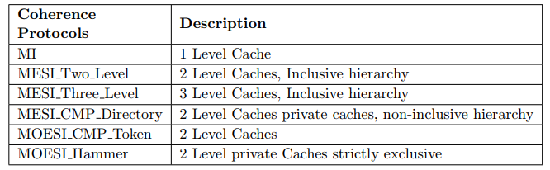
Gem5
Memory Systems:
Ruby memory model:

Slide 32
Contributions
Simulate snoopy based cache coherence on Gem5 and observe the behavior with respect to different parameters.
Simulate directory based coherence and protocol evolution.
Modification in Gem5 source code for Simulation of benchmark.

Slide 33
Implementation Plan
OS: Ubuntu 18.04
We plan to use Gem5 in:
mode: SE mode
ISA : X86 architecture
Memory Systems: Classic and Ruby
Benchmark: Splash-2 (parallel application like fft, lu and radix)

Slide 34
Metrics for analysis
Classic memory model:
Snoop data and Number of cores
For varying L1 cache size and cache block size:
Test execution time
CPU memory references
Total data through bus
Total snoop data through bus.
Ruby memory model:
Miss Rate
MESI_Two_level vs MESI_Three_level
MOESI_CMP_directory vs MOESI_CMP_token

Slide 35
Reference
[1]. N. B. Mallya, G. Patil and B. Raveendran, "Simulation based Performance Study of Cache Coherence Protocols," 2015 IEEE International Symposium on Nanoelectronic and Information Systems, Indore, 2015, pp. 125-130.doi: 10.1109/iNIS.2015.52.
[2]. J. K. Archibald, “The Cache Coherence Problem in Shared-Memory Multiprocessors”, Ph.D. Dissertation, Dept. Comput. Sci., Uni. Of Washington, 1987.
[3]. M.R. Marty, “Cache Coherence Techniques for Multicore Processors”, Ph.D. Dissertation, Dept. Comput. Sci., Uni. Of Wisconsin-Madison, 2008.
[4]. http://gem5.org/Cache_Coherence_Protocols
[5]. Nick Barrow-Williams, Christian Fensch, and Simon Moore. A communication characterisation of splash-2 and parsec. In Workload Characterization, 2009. IISWC 2009. IEEE International Symposium on, pages 86–97. IEEE, 2009 .
[6]. http://www.gem5.org/Splash_benchmarks

Slide 36


